Slide 1
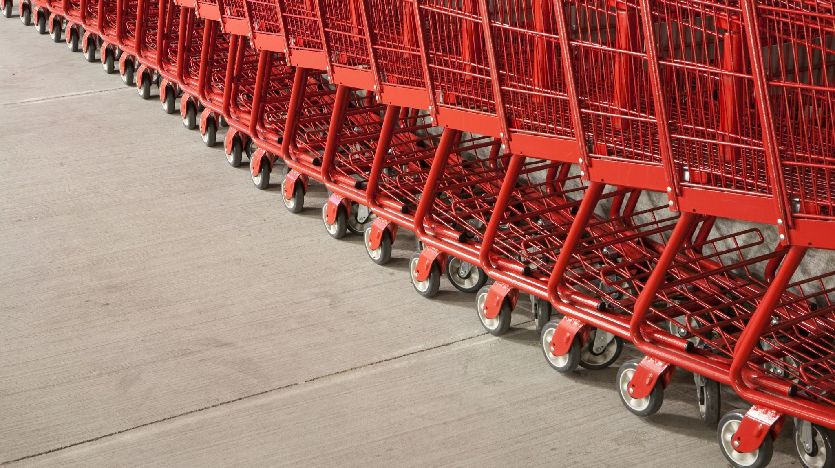
E-Commerce Platform for Local Craftmen: Vikreta
BY GROUP 301

Slide 2

TEAM MEMBERS
21MEI10060 | Kuldeep Kumar Jha
21MEI10022 | Yashwardhan Rastogi
21MEI10012 | Sanskar Singh Chandel
21MEI10050 | Manjari Sharma
21MEI10021 | Pankaj Kumar
21MEI10056 | Jatin Aggarwal
21MIM10002 | Rahul Nihalani
21MIM10003 | Shwetank Thakur
21BCE11284 | Aman Rathor
21BCY10106 | Aryan Thapa

Slide 3

TABLE OF CONTENTS
INTRODUCTION
OBJECTIVES
PROBLEM STATEMENT
PROPOSED SOLUTION
SYSTEM ARCHITECTURE
INDIVIDUAL'S CONTRIBUTION
CONCLUSION

Slide 4

INTRODUCTION
An innovative online marketplace that empowers local craftsmen to reach a wider audience and promote their unique, handcrafted products. This platform will not only serve as a marketplace but will also integrate cutting-edge technologies to enhance the user experience and streamline operations. Features like Automated Filtration and Recommendation mechanism and secured data storing will give us quality points.

Slide 5
OBJECTIVES
Automated Filtration and Recommendation: We incorporate artificial intelligence to enhance the product search and recommendation system. The AI will analyze user preferences, purchase history, and other data to provide personalized product recommendations, thereby improving the overall shopping experience.
Blockchain Integration: We are implementing blockchain technology to ensure transparent product listings and transactions, providing a high level of trust and reducing fraudulent activities.
User-Friendly Interface: The platform will be designed with a responsive and user-friendly interface, accessible on various devices.
Secure Payment System: We will implement a robust and secure payment system to protect both buyers and sellers during transactions.
Seller Profiles: Each local craftsman will have a dedicated seller profile, enabling them to showcase their craftsmanship, share their stories, and build a loyal customer base.

Slide 6

PROBLEM STATEMENT
Local craftsmen face significant challenges in showcasing and selling their traditional crafts to a wider audience. Many artisans lack an online presence, limiting their reach and potential customer base. The absence of dedicated platforms tailored to their needs hampers their ability to overcome logistical and marketing obstacles, hindering the growth of their craft businesses. There is a pressing need for an inclusive and user-friendly online platform that empowers local craftsmen to overcome these challenges and connect with a broader customer base.

Slide 7
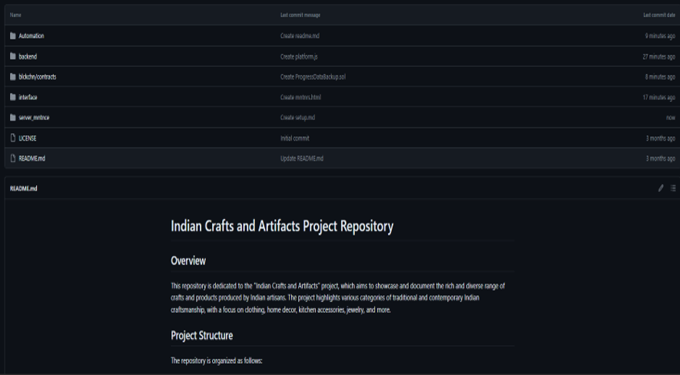
PROPOSED SOLUTION
Our proposed solution involves the creation of a specialized website, hereafter referred to as "Vikreta," designed specifically for local craftsmen. Vikreta aims to provide a user-friendly and accessible online space where artisans can showcase and sell their traditional crafts. The platform will offer easy-to-use tools for creating and managing product listings, allowing craftsmen to present their work in an appealing and marketable manner.
To address logistical challenges, Vikreta will incorporate features facilitating secure online transactions, order management, and shipping logistics. Moreover, the website will implement a review and rating system to build trust between craftsmen and customers. To enhance visibility, the platform will employ effective digital marketing strategies, leveraging social media and search engine optimization to promote the crafts and the craftsmen behind them.

Slide 8








Tech Stack Used:
TRPC FRAMEWORK
BLOCKCHAIN
CMS PAYLOAD
RESEND

Slide 9
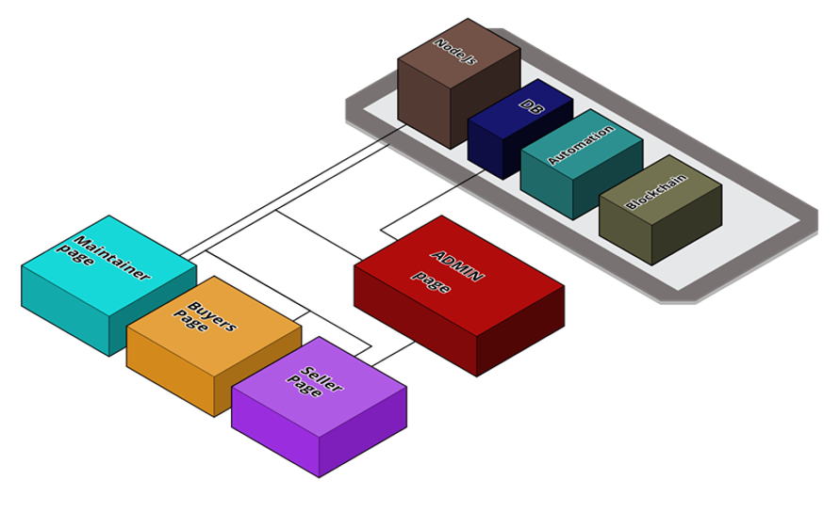
System Architecture

Slide 10
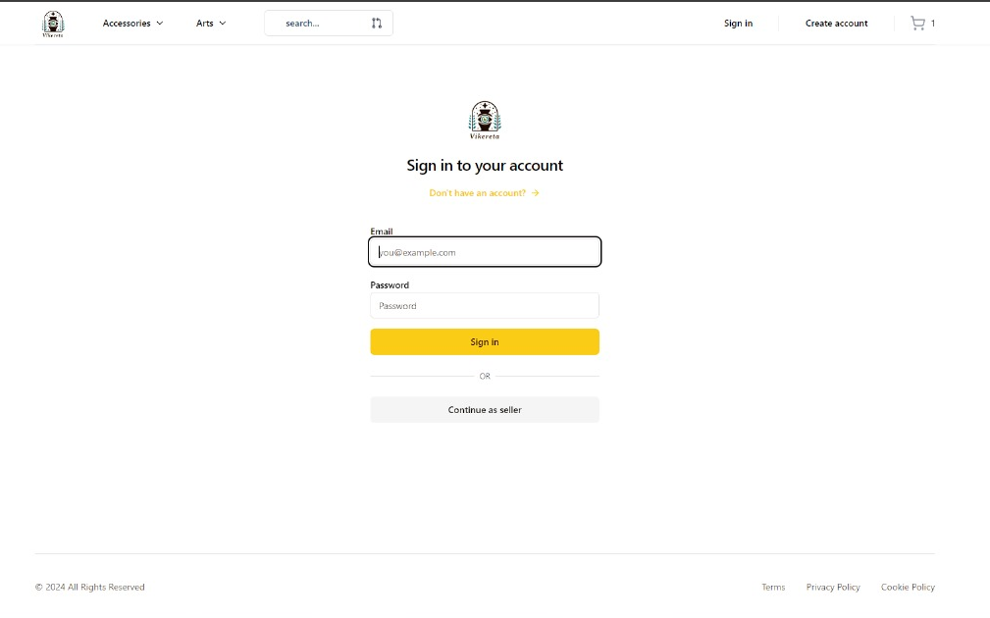
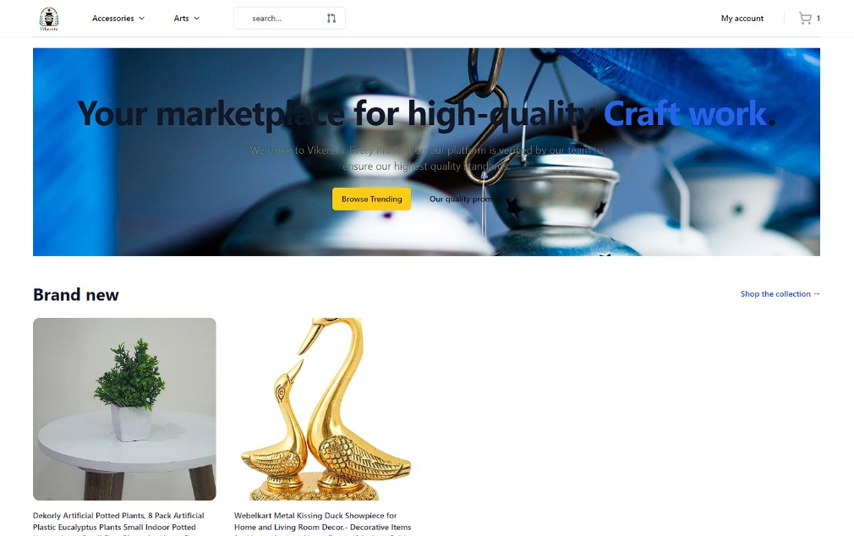
Frontend Interface
SIIGN IN/ SIGN UP PAGE
HOME PAGE

Slide 11
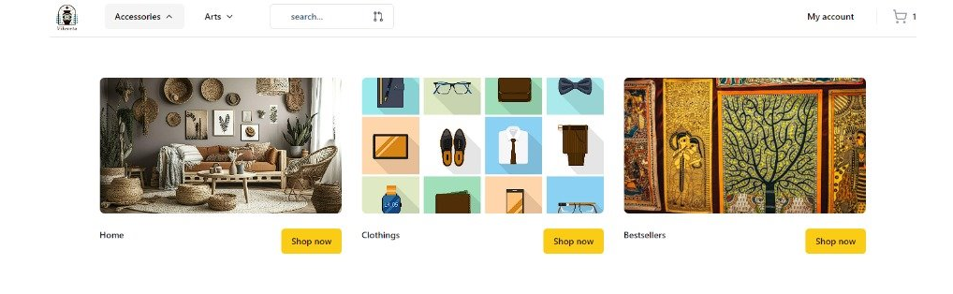
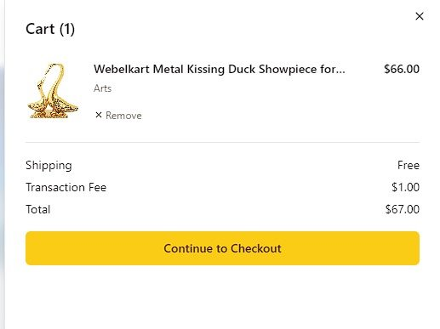
To be continued...
NAVIGATION BAR
CART INTERFACE

Slide 12
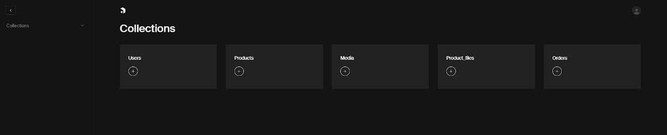
Backend Interface:
ADMIN PANEL
Node.js and Express Backend: Utilizes Node.js and Express for robust server-side architecture.
RESTful API Development: Express framework simplifies the creation of RESTful APIs for seamless client-server communication.
Middleware Integration: Employing body-parser middleware for parsing incoming request bodies, enhancing data extraction from client requests.
PostgreSQL Database Integration: Interfaces with PostgreSQL database using pg library for structured and efficient data storage and retrieval.
Data Management: Ensures persistent storage of information related to sellers, buyers, and other entities for seamless application functionality.
Security Implementation: Prioritizes security with bcrypt library integration for securely hashing and storing passwords, safeguarding user credentials.
Prevention of Unauthorized Access: Measures implemented to prevent unauthorized access to sensitive information, enhancing overall security posture of the application.

Slide 13
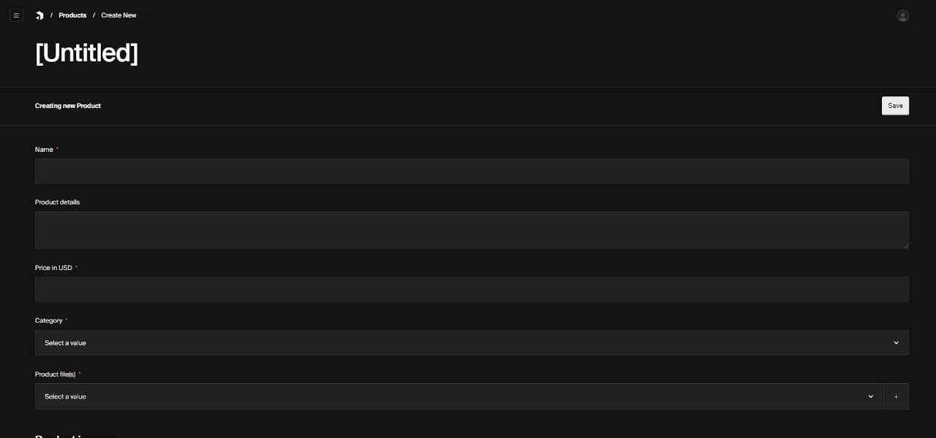
PRODUCT ADD MENU

Slide 14
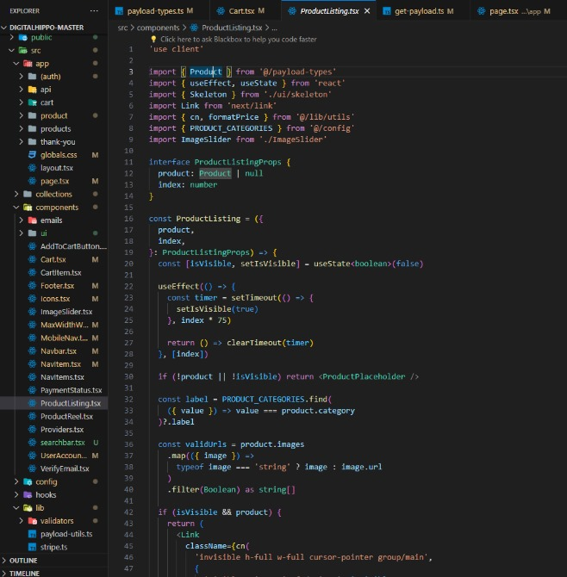
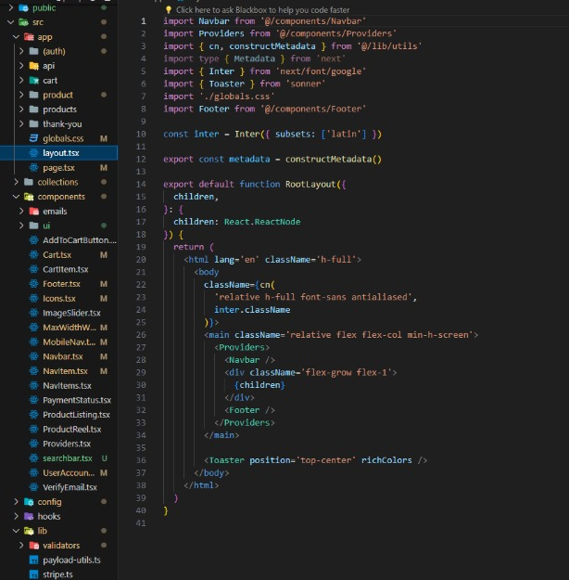
PRODUCT LISTING CODE
PAGE LAYOUT CODE

Slide 15
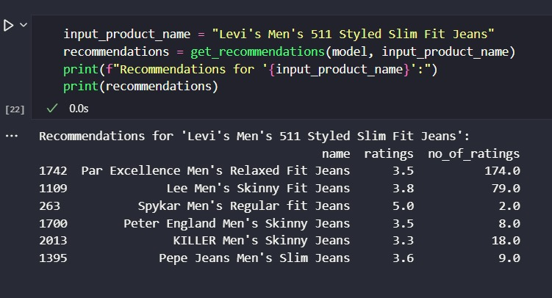
Automation:
The algorithm is meticulously crafted to furnish personalized product recommendations based on user interactions and preferences. Leveraging the power of machine learning, the recommendation system employs sophisticated data processing scripts to collect and preprocess data, ensuring the algorithm's accuracy. The setup includes:
Collaborative Filtering
Deep Learning Model
Categories
Ratings
Recommender System
Dataset (Kaggle) Fine-Tunning

Slide 16
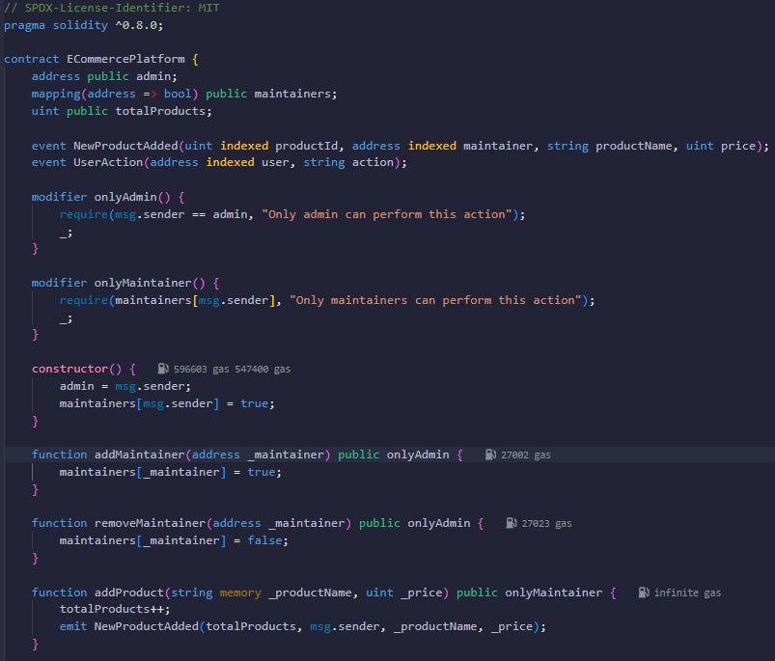
Blockchain:
Decentralized Storage: Explore how blockchain technology is employed to establish a decentralized storage mechanism.
Transparency and Immutability: Delve into the features of blockchain that guarantee transparency, immutability, and tamper-proofing of data.
Redundancy for Data Resilience: Examine the role of distributed nodes in achieving redundancy across the blockchain network.
Smart Contract Automation: Explore the use of smart contracts in automating and enforcing backup procedures.
Trustless and Auditable Environment: Discuss the creation of a trustless and auditable environment through blockchain-based backup solutions.

Slide 17
Individual's Contribution
Student Name | Registration Number | Contribution
Kuldeep Kumar Jha | 21MEI10060 | Backend, Tech Stack Finalization
Yashwardhan Rastogi | 21MEI10022 | Payment Gateway, Backend Integration
Sanskar Singh Chandel | 21MEI10012 | Frontend(Product Listing, Admin, Maintainers, Seller, Buyers)
Manjari Sharma | 21MEI10050 | Blockchain Integration, product Listing
Pankaj Kumar | 21MEI10021 | Frontend(Product Listing, Admin, Maintainers, Seller, Buyers)
Jatin Aggarwal | 21MEI10056 | Backend, Payment Gateway
Rahul Nihalani | 21MIM10002 | Product Recommendation Systems (AI)
Shwetank Thakur | 21MIM10003 | Product Recommendation Systems (AI)
Aman Rathor | 21BCE11284 | Frontend(Product Listing, Admin, Maintainers, Seller, Buyers)
Aryan Thapa | 21BCY10106 | Frontend, Payment Gateway

Slide 18
CONCLUSION
In summary, Vikreta offers a tailored solution to empower local craftsmen by providing a user-friendly platform for showcasing and selling traditional crafts. With a focus on overcoming logistical barriers, implementing secure transactions, and leveraging digital marketing, Vikreta addresses key challenges. The platform's commitment to inclusivity ensures accessibility for craftsmen of all technological backgrounds. Vikreta represents not just a website but a catalyst for the economic growth and cultural preservation of traditional crafts, promising a vibrant future for local artisans.

Slide 19

THANK YOU

